Slide 1
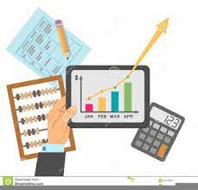
Corporate Financial statements -2

Slide 2
Quick Revision
Patents and copyrights fall under the category of:
(a) Current Assets
(b) Liquid Assets
(c) Intangible Assets
(d) None of these

Slide 3
Abacus Ltd. follows the Written down value Method of depreciating machinery year after year due to -
a) Consistency
b) All the above
c) Convenience
d) Comparability

Slide 4

Learning outcomes
Examine the financial statements in the light of the current regulatory framework
Develop skills to analyze corporate financial statements and disclosures

Slide 5
An income statement is a financial statement that shows you the company’s income and expenditures. It also shows whether a company is making profit or loss for a given period.

Slide 6
Statement of Profit and Loss will comprise of 2 sections-
1. Profit and loss items
2. Other comprehensive income

Slide 7
Poll
Debit Balance of Profit & Loss Statement will be shown on:
(a) Assets Side of Balance Sheet
(b) Liabilities Side of Balance Sheet
(c) Under the head Reserve & Surplus
(d) Under the head Reserves and Surplus as a negative item

Slide 8
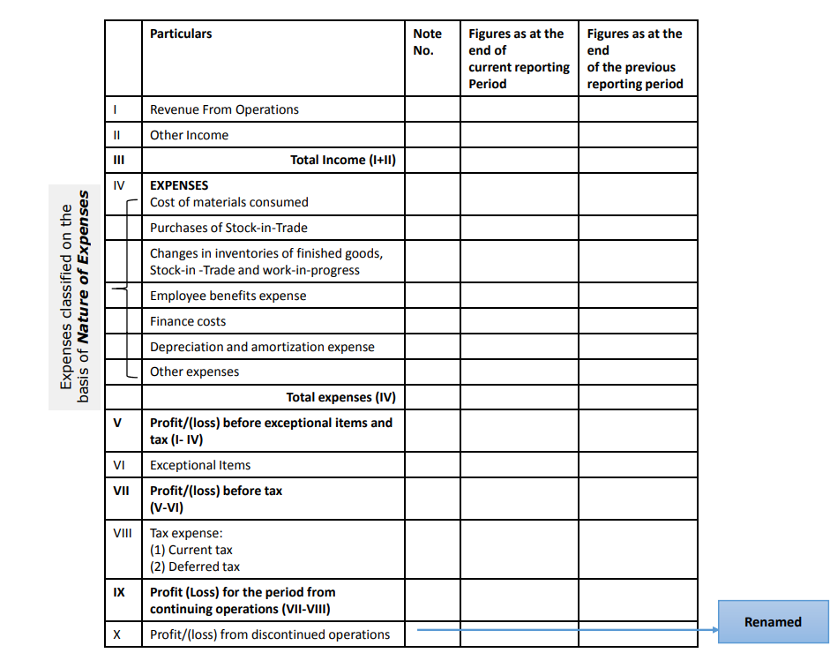

Slide 9
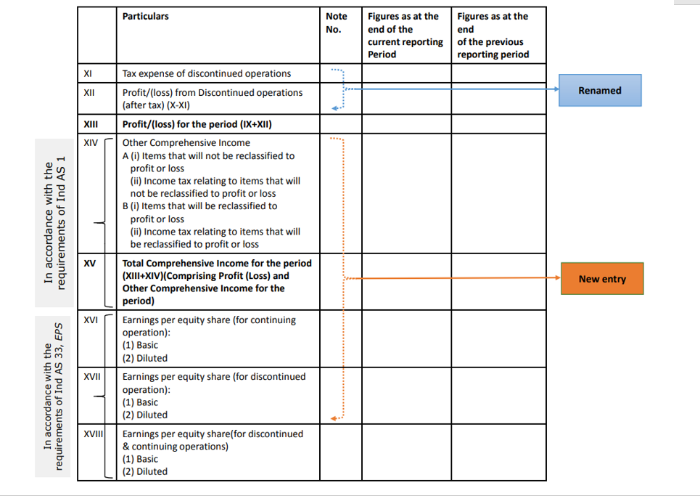

Slide 10
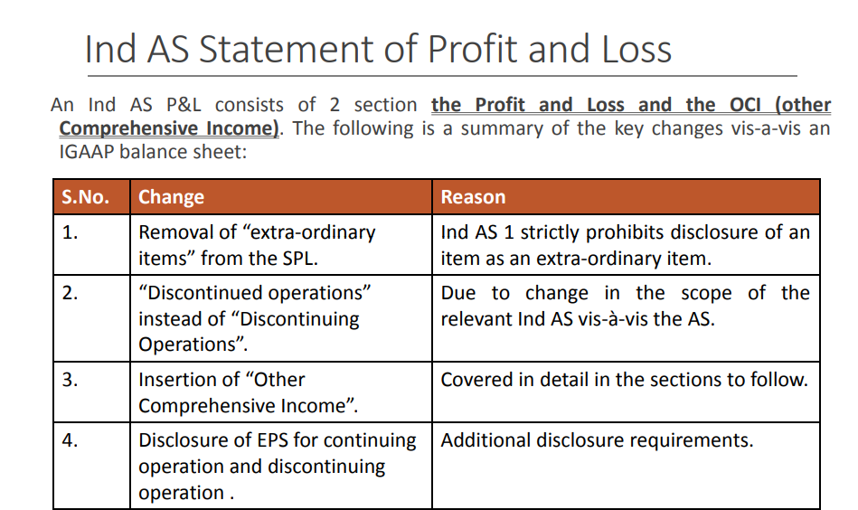

Slide 11
Sec 1- Profit and loss items

Slide 12
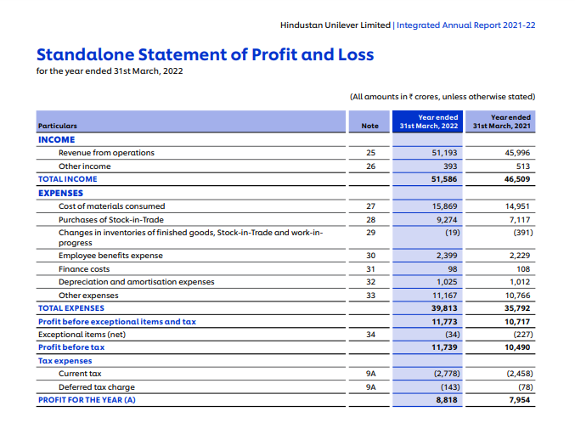

Slide 13
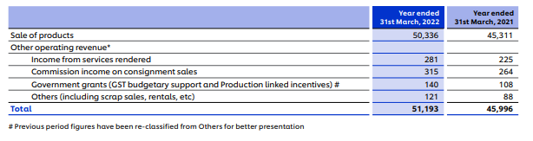
Revenue from Operations
In respect of a company other than a finance company revenue from operations shall disclose separately in the notes revenue from—
(a) Sale of products;
(b) Sale of services;

Slide 14
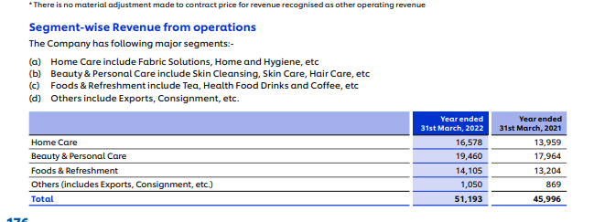

Slide 15
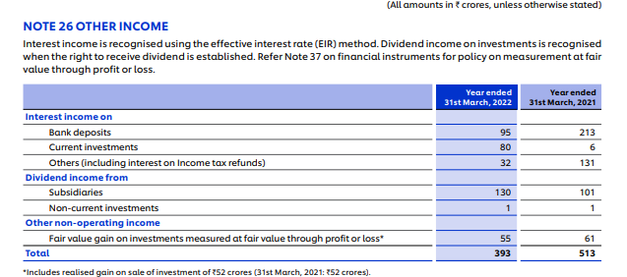
Other income shall be classified as:
(a) Interest Income (in case of a company other than a finance company);
(b) Dividend Income;
(c) Net gain/loss on sale of investments;
(d) Other non-operating income (net of expenses directly attributable to such income).

Slide 16
A company sold the old machinery worth RS.50,00,000 for Rs 60,00,000. Gain on the sale of machinery will be termed as
Revenue from operations
Other comprehensive incomes
Total comprehensive income
None of the above
Notes:
Other comprehensive incomes

Slide 17
A Company shall disclose by way of notes additional information regarding aggregate expenditure and income on the following items:—
Employee Benefits Expense
Depreciation and amortization expense;
Interest Income;
Interest expense;
Dividend income;
Net gain/loss on sale of investments;
Adjustments to the carrying amount of investments;
Payments to the auditor a
Net gain or loss on foreign currency transaction and translation (other than considered as finance cost);
The amount of expenditure incurred on corporate social responsibility activities;
Details of items of exceptional and extraordinary nature;

Slide 18
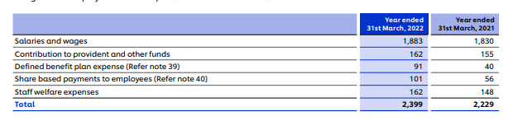
Employee Benefits Expense
Includes-
i) salaries and wages,
(ii) contribution to provident and other funds,
(iii) expense on Employee Stock Option Scheme (ESOP) and Employee Stock Purchase Plan (ESPP),
(iv) staff welfare expenses

Slide 19
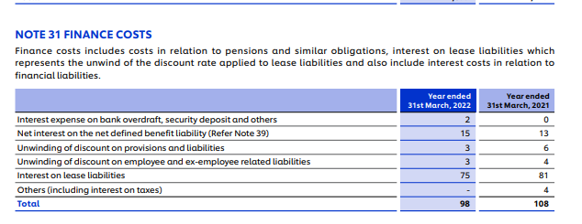
Finance Costs
Finance costs shall be classified as:
(a) Interest expense;
(b) Other borrowing costs;
(c) Applicable net gain/loss on foreign currency transactions and translation.

Slide 20
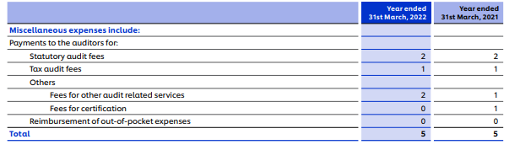
Payments to the auditor as
(a) auditor;
(b) for taxation matters;
(c) for company law matters;
(d) for management services;
(e) for other services; and
(f) for reimbursement of expenses;

Slide 21
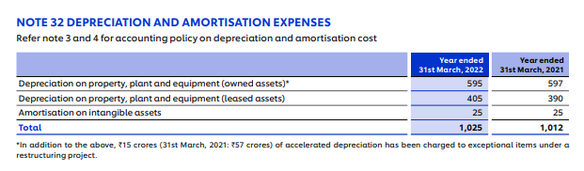
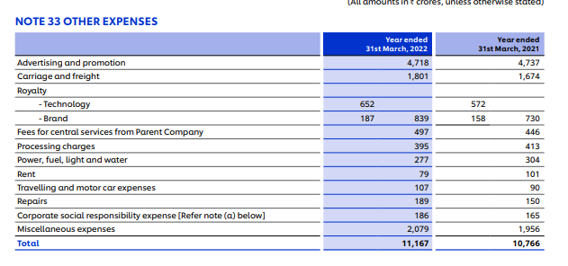
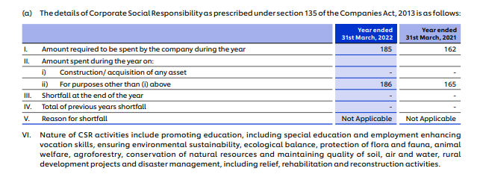

Slide 22
it arises from a event or transaction that are clearly distinct from ordinary business;
this items are not expected to recur frequently or regularly;
this item is disclosed in the statement of profit and loss as a part of net profit for the period.
They are generally disclosed to notes to financial statement

Slide 23
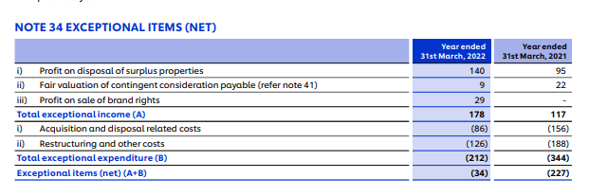

Slide 24
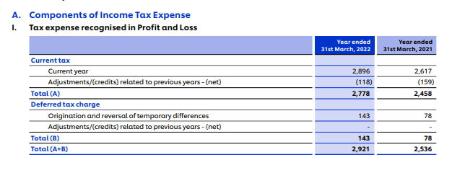
Tax Expenses
Income tax expense for the year comprises of current tax and deferred tax.
Notes:
It is recognized in the standalone statement of profit and loss except to the extent it relates to a business combination or to an item which is recognized directly in equity or in other comprehensive income.

Slide 25
Tax Expenses
Current tax is the expected tax payable/receivable on the taxable income/loss for the year using applicable tax rates for the relevant period, and any adjustment to taxes in respect of previous years. Interest expenses and penalties, if any, related to income tax are included in finance cost and other expenses respectively. Interest Income, if any, related to income tax is included in other income

Slide 26
Tax Expenses
Deferred tax is recognized in respect of temporary differences between the carrying amount of assets and liabilities for financial reporting purposes and the corresponding amounts used for taxation purposes.

Slide 27
Cost or expenses must be recorded at the same time as the revenue to which they correspond is specified by which principle?
(a) Matching Principle
(b) Going Concern Principle
(c) Consistency Principle
(d) Prudence Principle
Notes:
a

Slide 28
Section -2 Other comprehensive income

Slide 29
What is OCI?
comprising of items of income and expense (including reclassification adjustments) that are not recognized in profit or loss as required or permitted by other Ind ASs
Why OCI?
Providing cushion to the Profits.
Reflecting notional gains and losses outside the profit(loss).
A barometer for upcoming threats or windfalls to net income (as it contains profit/loss on change in fair value for certain items).

Slide 30
Few Examples
Changes in revaluation surplus
Gains and losses arising from translating the financial statements of a foreign operation

Slide 31
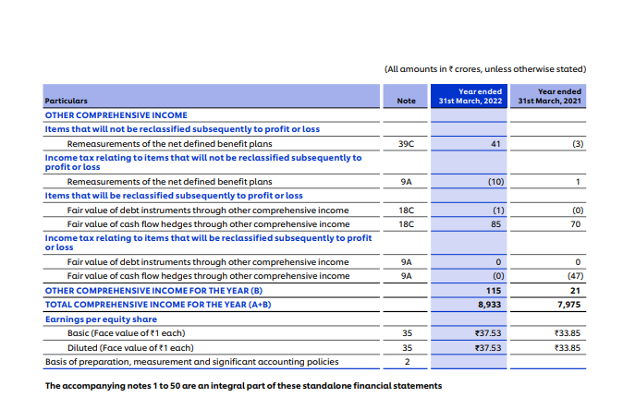

Slide 32
Total Comprehensive Income
Total Comprehensive Income is different from Other Comprehensive Income and can be better understood as follows:
Total Comprehensive Income
Profit or loss of the period
OCI

Slide 33
Valuation of stock at lower of cost or net realizable value is an example of:
a) Conservatism
b) Realization Concept.
c) Matching concept
d) Consistency

Slide 34


Your Turn: Coffee Shop Products
Think about the coffee shop in your area. Identify items the coffee shop sells that would be classified as revenues.
Mention the revenue from operations of coffee shop
Notes:
Remember, revenues for the coffee shop are related to its primary purpose: selling coffee and related items.

Slide 35
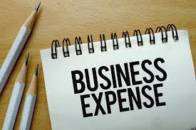
Your Turn: Coffee Shop Expenses
While thinking about or visiting the coffee shop in your area, look around (or visualize) and identify items or activities that are the expenses of the coffee shop.

Slide 36
STATEMENT OF CHANGES IN EQUITY
The statement of changes in equity is a reconciliation of the beginning and ending balances in a company’s equity during a reporting period.
It is not considered an essential part of the monthly financial statements, and so is the most likely of all the financial statements not to be issued.

Slide 37
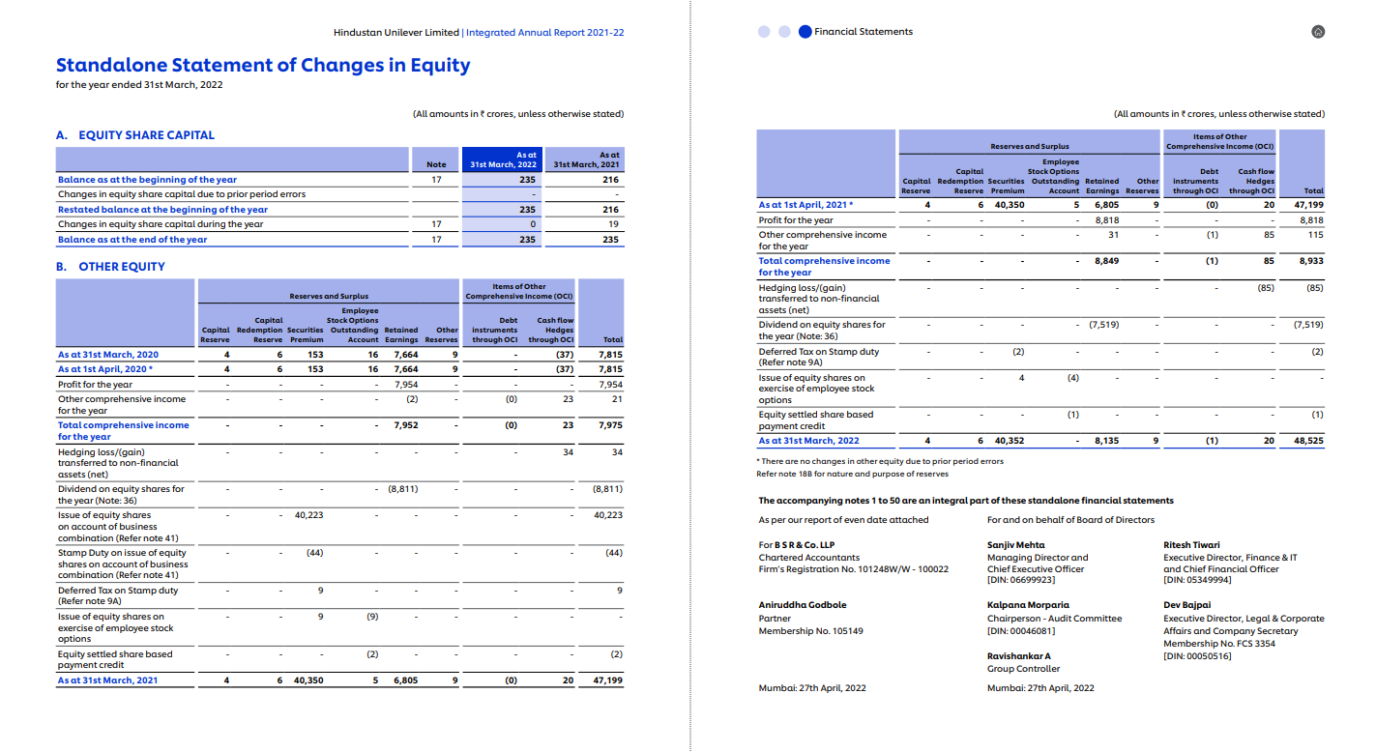

Slide 38
STATEMENT OF CASH FLOWS

Slide 39
STATEMENT OF CASH FLOWS
The statement of cash flows, or the cash flow statement, is a financial statement that summarizes the Inflow and outflow a of cash from three major activities
1) Operating
2) Investing
3) Financing

Slide 40


